Slide 1

Lab Session
***IMPORTANT***
Take as many screen shots of the work you are doing to use in the lab report

Slide 2
Schedule
Grading Criteria
9.00 a.m. to 1.15 p.m. – FPGA hands-on Lab Session
1.15 p.m to 2.00 p.m - Lunch Break
2.00 p.m to 3.00 p.m – Summary and next steps
3.00 p.m to 4.00 p.m – Concluding Ceremony and Group Photo
Individual Report - Submission link available on moodle
Due: Sunday, 30 April 2023, 11:59 PM
Report describing the practical with observations
Source Code
Demo Video

Slide 3
Contents
AND Gate Implementation
4-bit Counter Implementation
UART MVM Implementation

Slide 4
Before We Start
Please download the source codes from the Github Repo (https://github.com/skillsurf/systemverilog)
Install the cable drivers - (Linux/Ubuntu Users) https://docs.xilinx.com/r/en-US/ug973-vivado-release-notes-install-license/Installing-Cable-Drivers

Slide 5
Example 01 : AND Gate

Slide 6
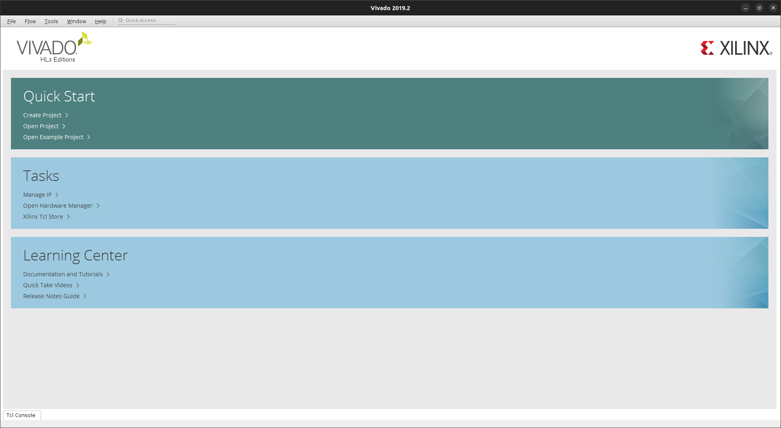

Slide 7
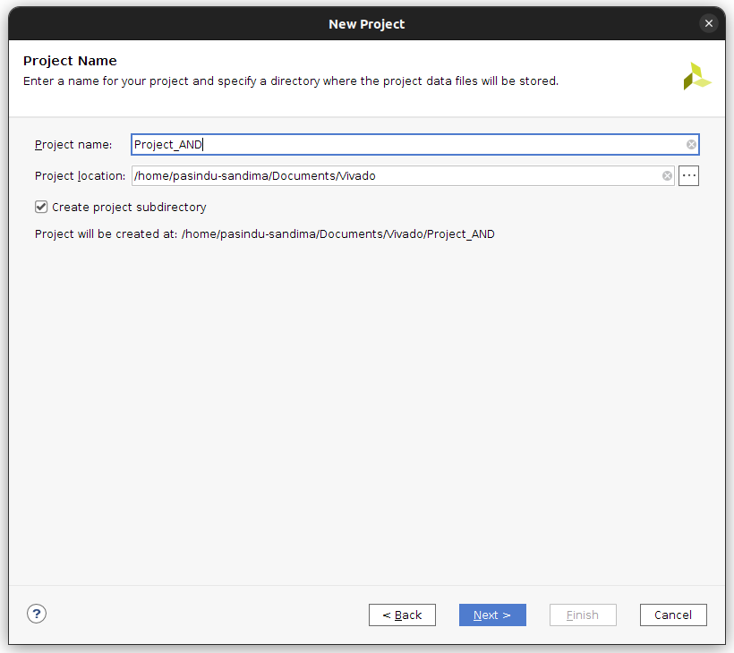

Slide 8
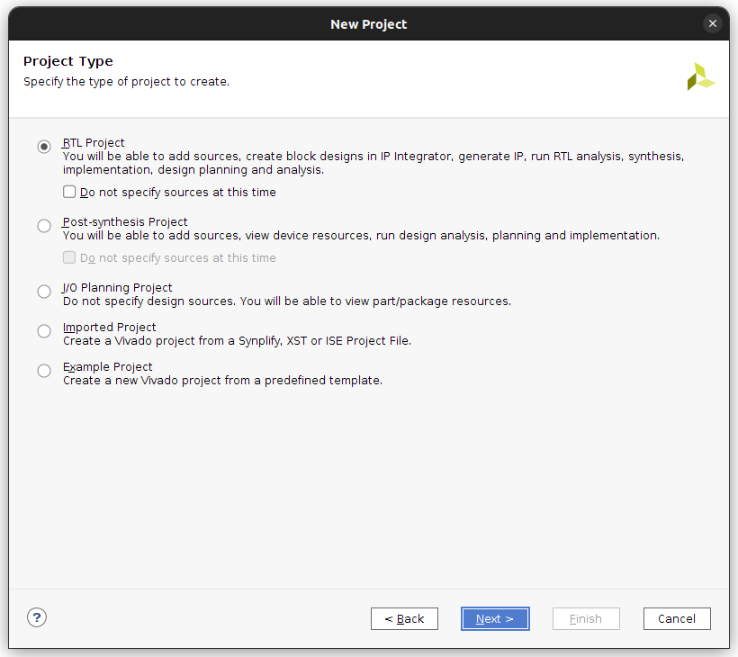

Slide 9
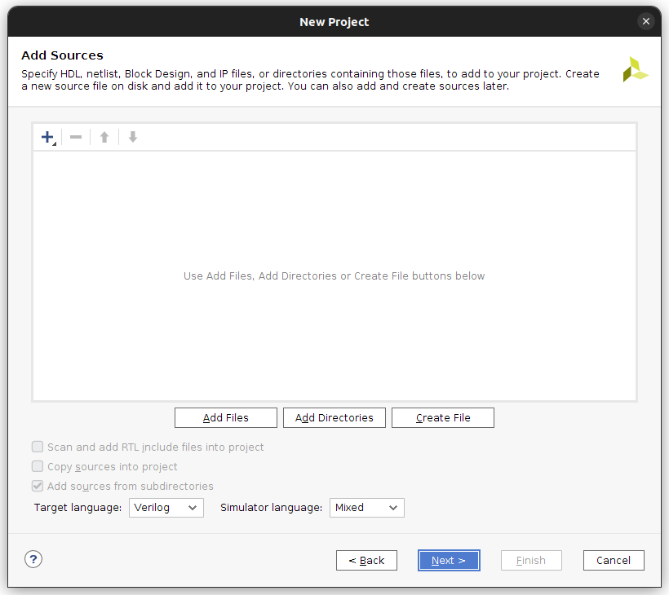
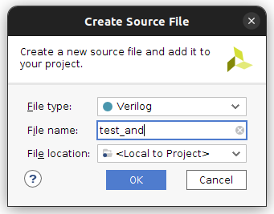
Select SystemVerilog here

Slide 10
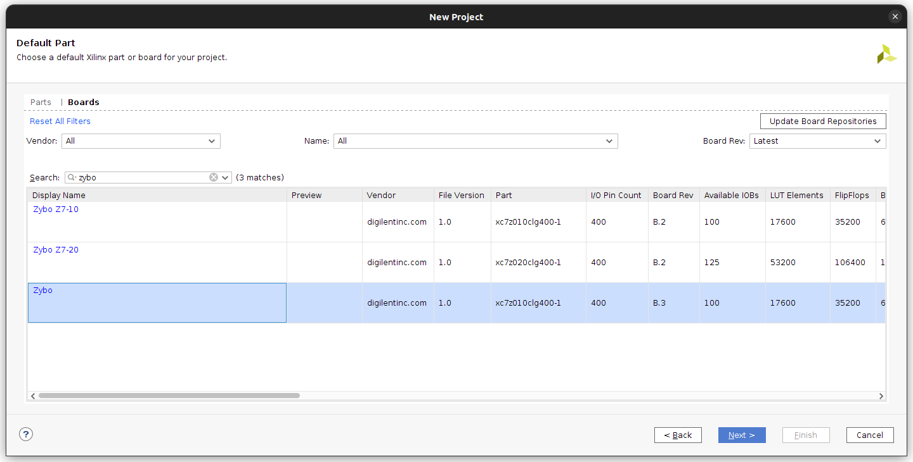

Slide 11
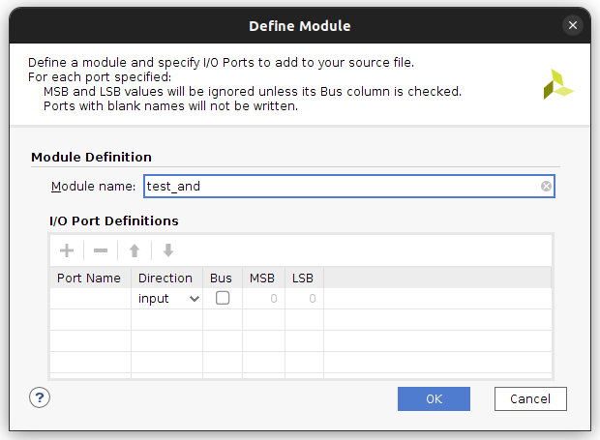

Slide 12
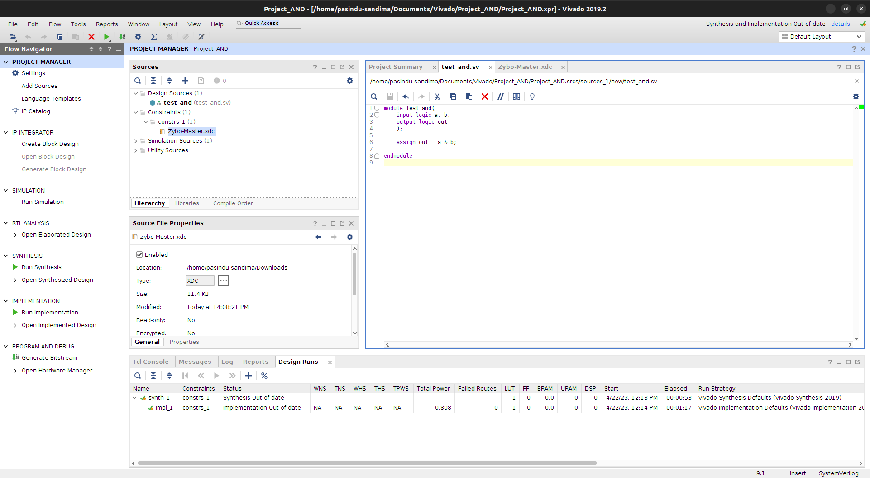

Slide 13
test_and.sv
module test_and(
input logic a, b,
output logic out
);
assign out = a & b;
endmodule

Slide 14
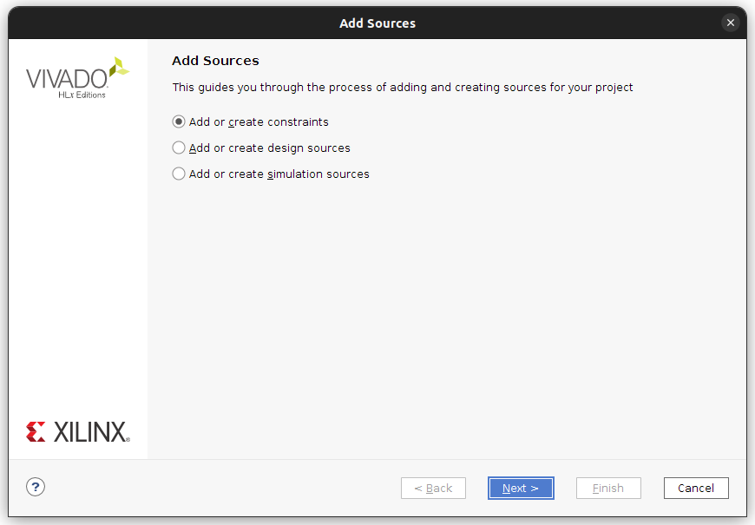
Path : https://github.com/SkillSurf/systemverilog/blob/master/board_constraints/Zybo-Master.xdc

Slide 15
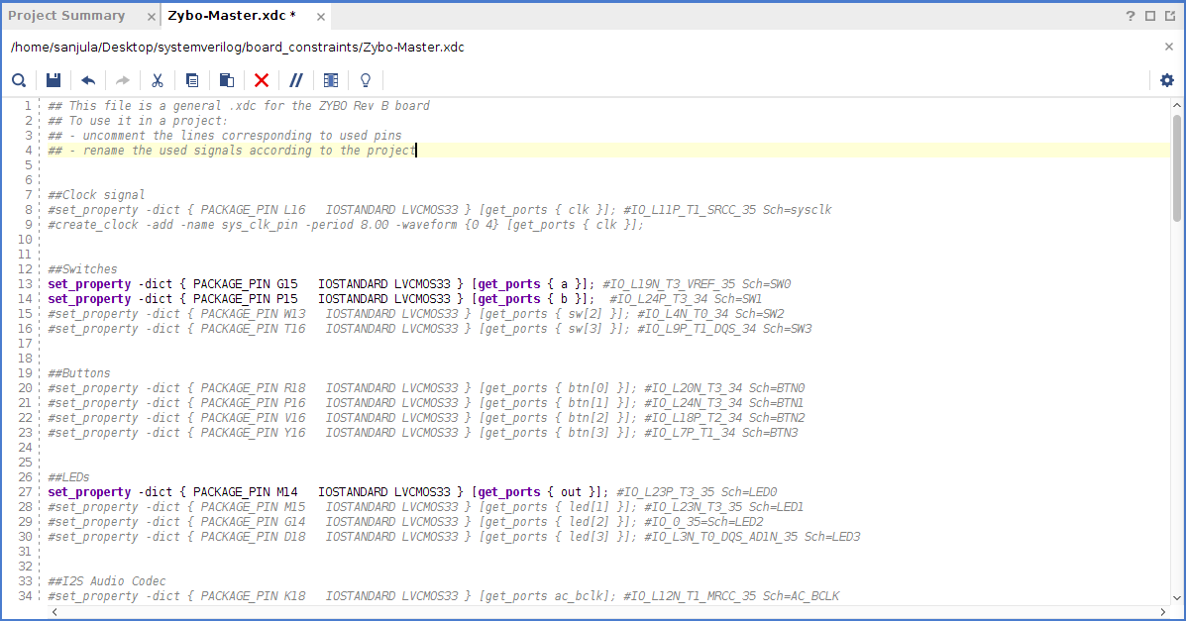

Slide 16
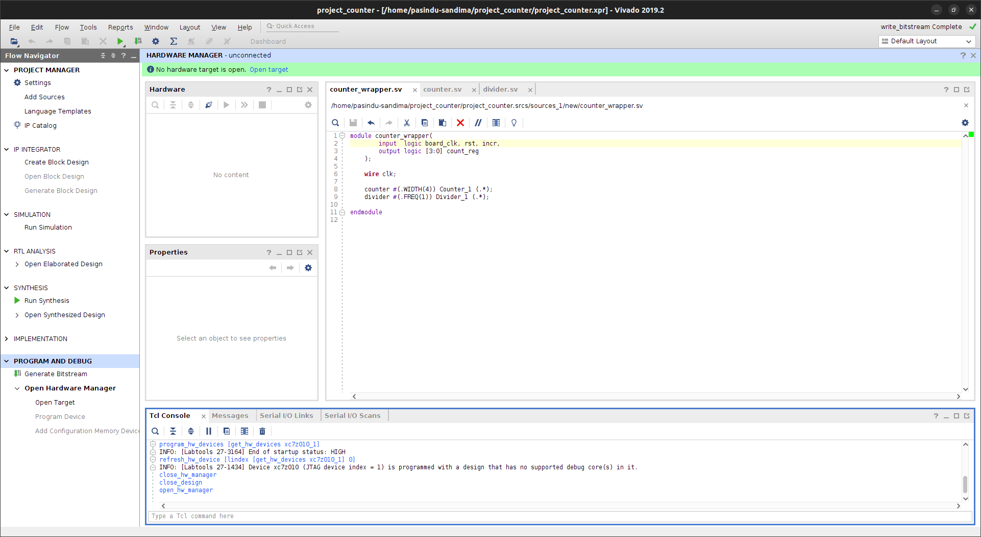

Slide 17
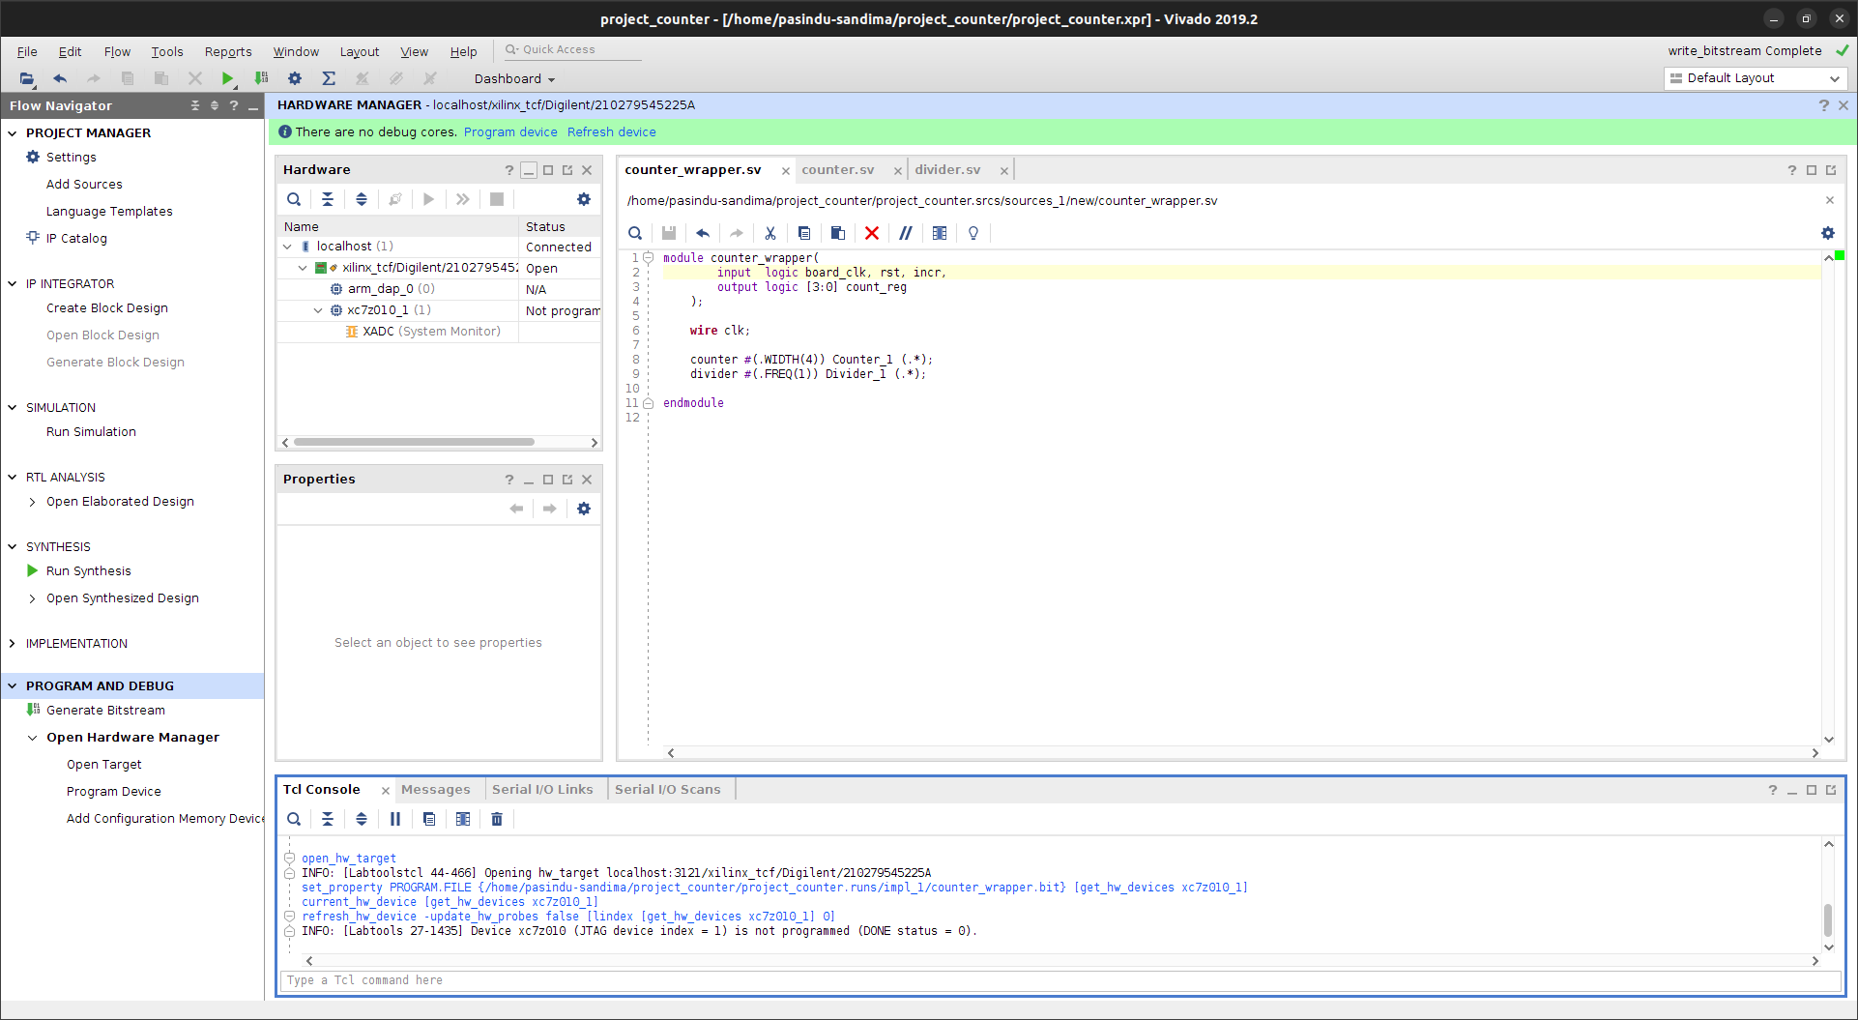

Slide 18
Example 02 : Counter

Slide 19
Block design:
Counter_wrapper
clk
Scaling down the on-board clock signal
counter
divider
rst
Performs Up Counting
count_reg
incr

Slide 20
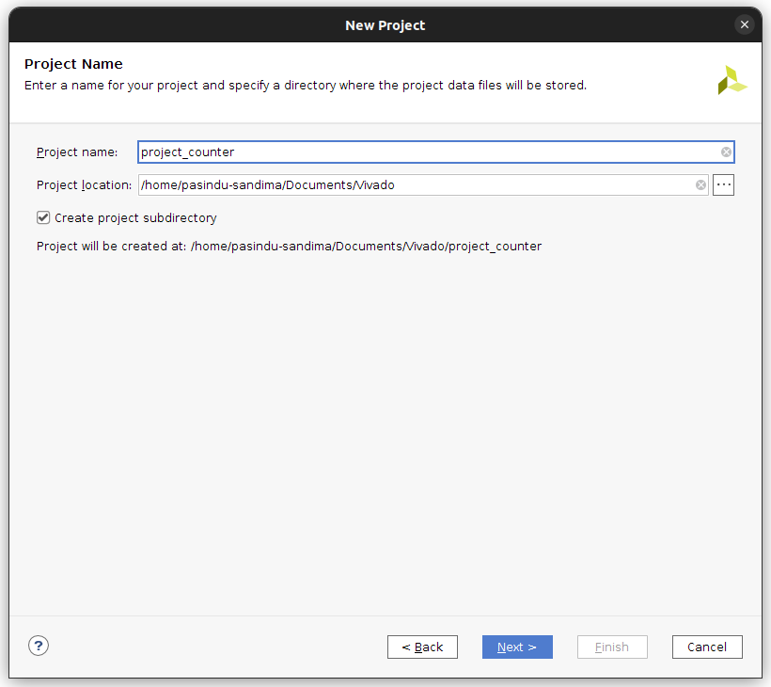


Slide 21
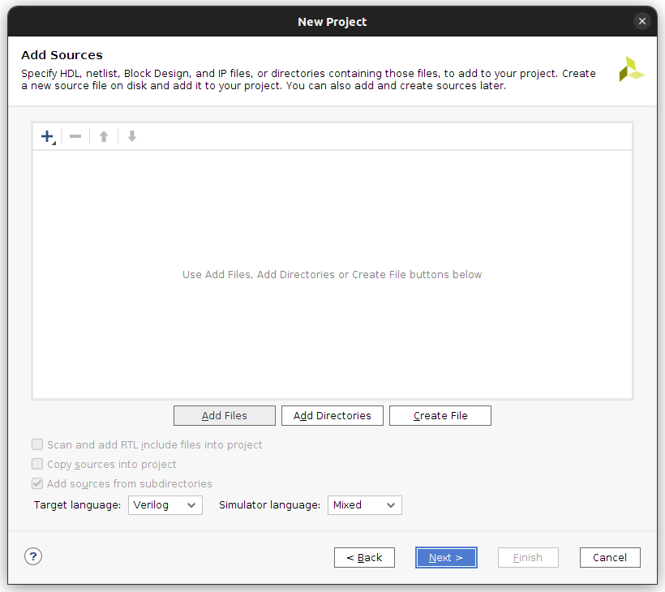
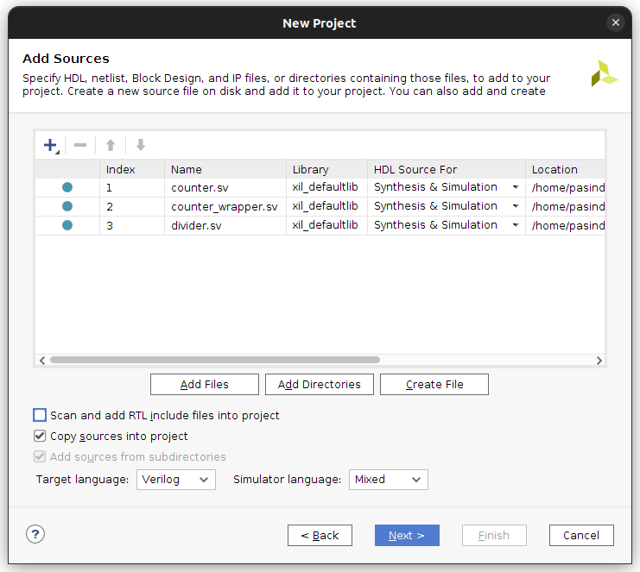

Slide 22
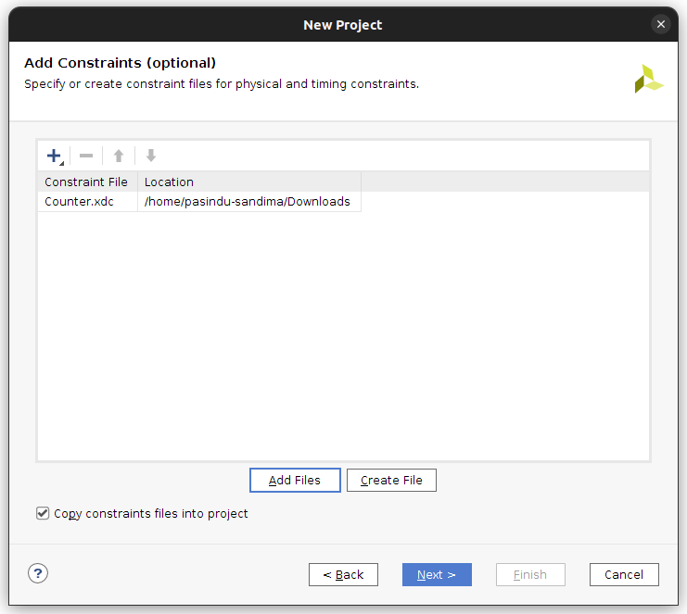
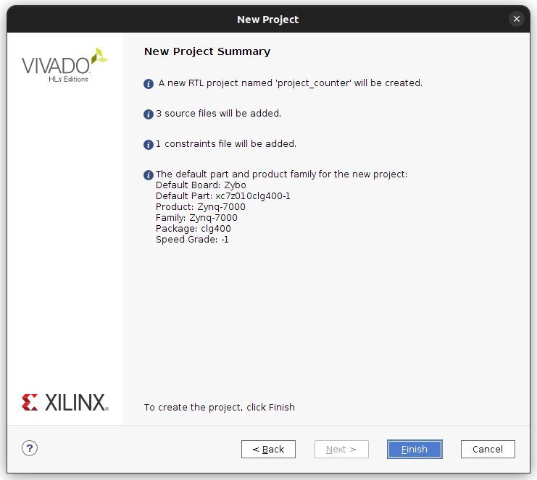

Slide 23
counter_wrapper.sv
counter.sv
divider.sv
module counter_wrapper(
input logic board_clk, rst, incr,
output logic [3:0] count_reg
);
wire clk;
counter #(.WIDTH(4)) Counter_1 (.*);
divider #(.FREQ(1)) Divider_1 (.*);
// FREQ set to 1 Hz
endmodule
module counter #(parameter WIDTH = 8)
(
input logic clk, rst, incr,
output logic [WIDTH-1:0] count_reg
);
always_ff @(posedge clk) begin
if (rst) count_reg <= 0;
else if (incr) count_reg <= count_reg + 1'b1;
end
endmodule
module divider #(parameter FREQ = 8)
(
input logic board_clk,
output logic clk
);
localparam COUNT_MAX = 125000000/(FREQ*2) - 1;
//125MHz Board Clock
logic [31:0] count_reg = 32'd0;
always_ff @(posedge board_clk) begin
if (count_reg == COUNT_MAX) count_reg <= 0;
else count_reg <= count_reg + 1'b1;
end
always_ff @(posedge board_clk) begin
if (count_reg == COUNT_MAX) clk <= ~clk;
else clk <= clk;
end
endmodule

Slide 24
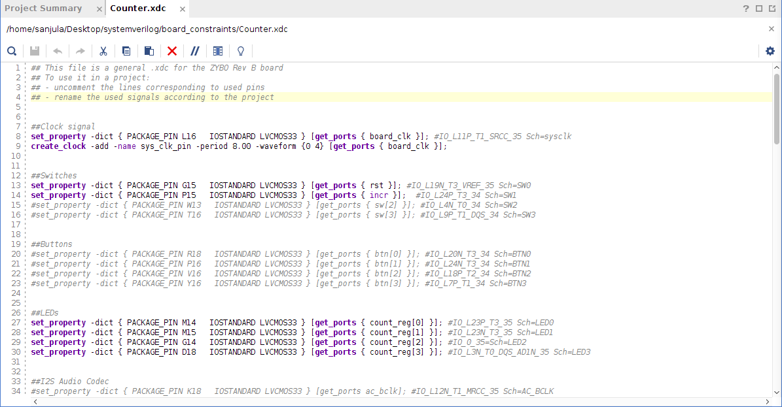

Slide 25
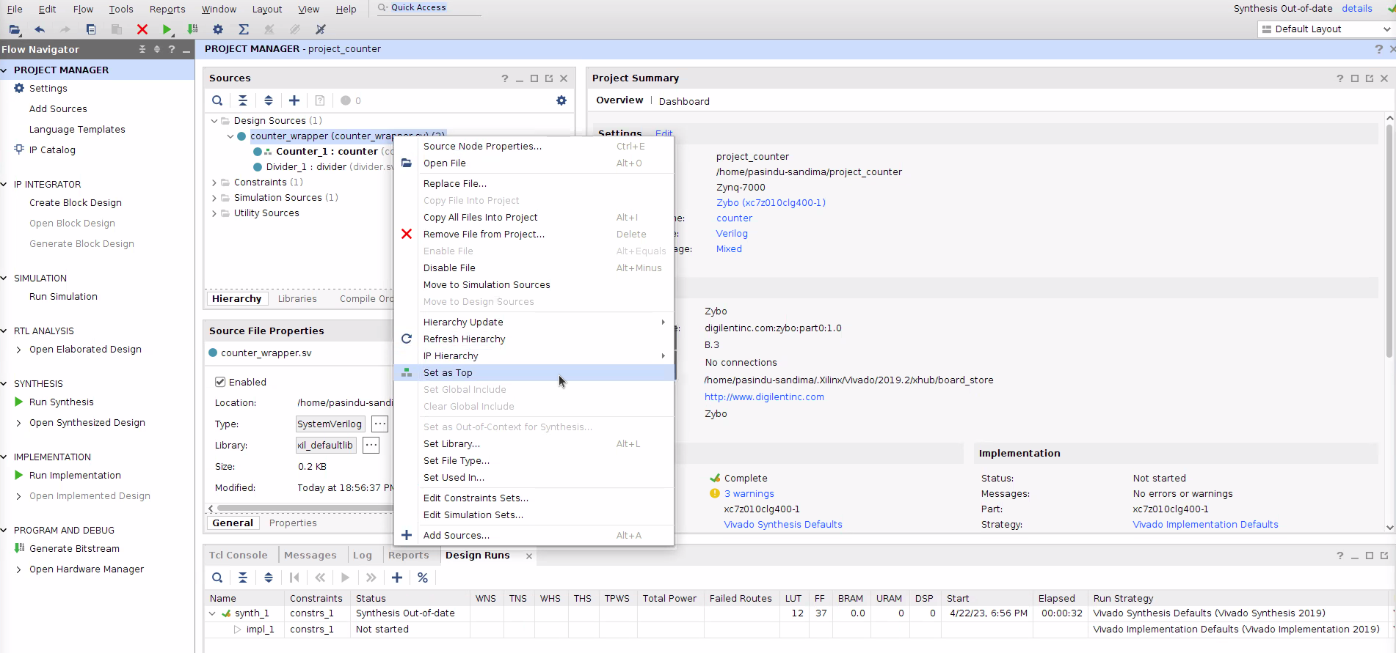

Slide 26
Troubleshooting
Installing Cable Drivers - https://docs.xilinx.com/r/en-US/ug973-vivado-release-notes-install-license/Installing-Cable-Drivers
Installing Zybo Board - https://digilent.com/reference/software/vivado/board-files

Slide 27
mvm_uart_system
Matrix Vector Multiply uart system

Slide 28
Block design:
mvm_uart_system
axis_matvec_mul
matvec_mul
uart_rx
skid_buffer
uart_tx
Convert serial input to parallel data
Translate result to serial output
rx
Performing multiplication on input
Handles AXI stream signals
tx

Slide 29
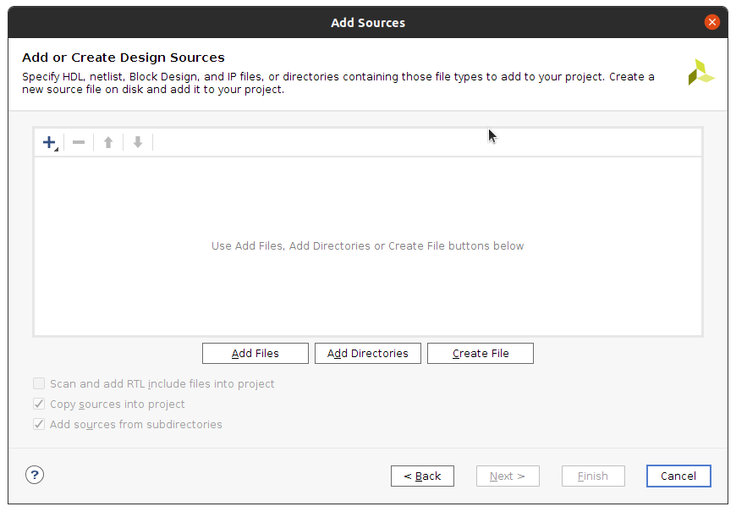
Importing files:

Slide 30
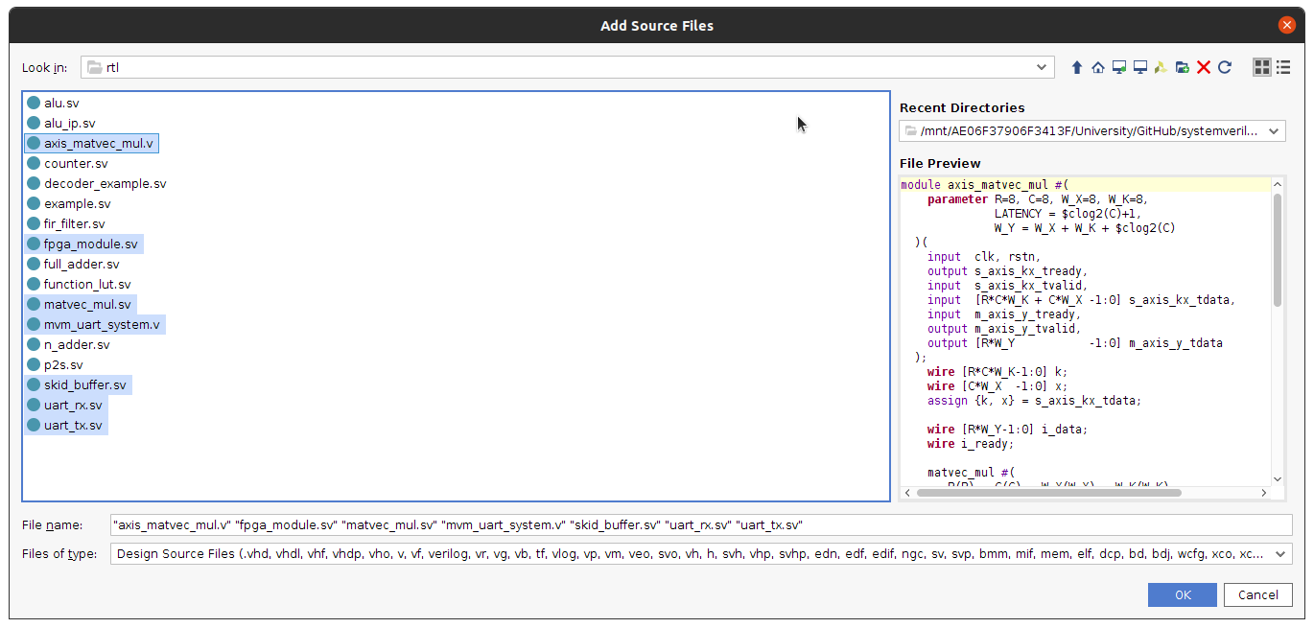
Importing files:

Slide 31
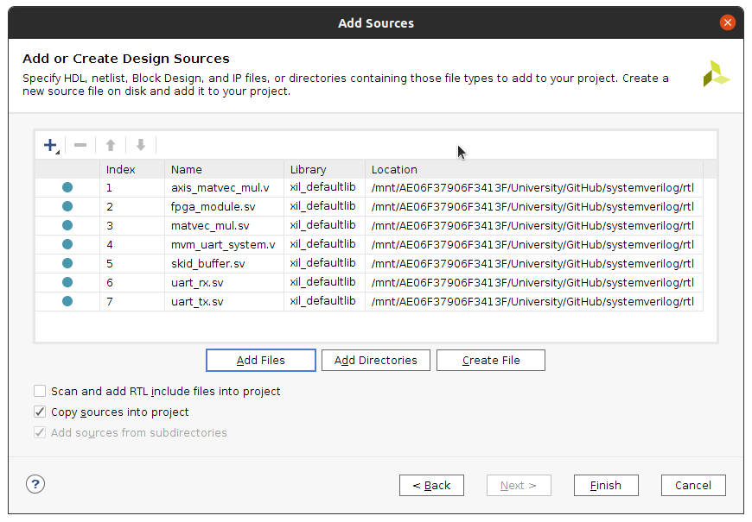
Importing files:

Slide 32
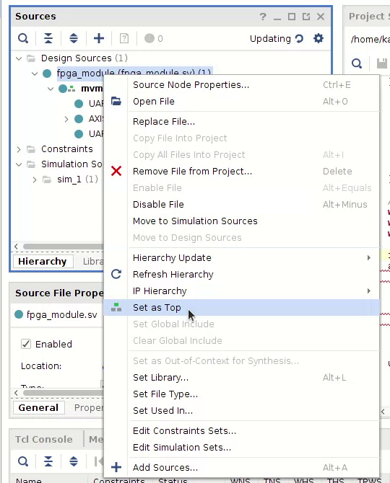
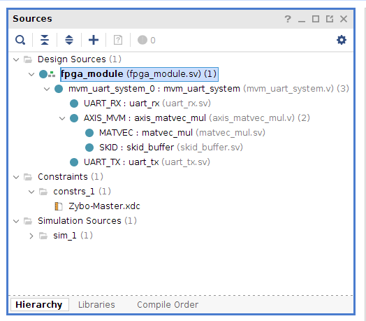
Importing files:
Make sure “fpga_module” is “Set as Top”

Slide 33
Synthesis
What is the problem that we are trying to address(i.e. What’s stopping us from skipping synthesis) ?
FPGA creates your circuit from a set of hardware primitives(LUTs & FFs)
We need to convert your hardware description in to hardware that the FPGA can implement
FPGA does not have discrete AND, OR, NOT gates that map exactly to lines in your code
We have to build everything with LUTs and FFs
How does synthesis help?
Synthesis converts our initial design into hardware that the FPGA can implement
Note: We don’t require a constraints file to do synthesis
What’s a constraints file and why don’t we need it?

Slide 34
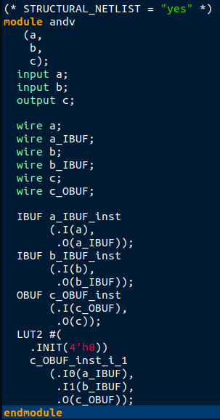
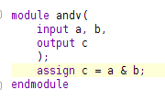
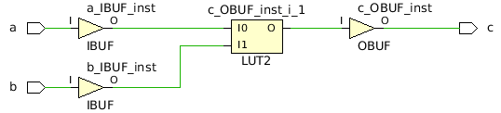
Synthesis example AND gate:
To export synthesized netlist. After synthesis,
File -> Export -> Export Netlist
Synthesized netlist(verilog)
Your code
The LUT which is configured as an AND gate
Synthesised schematic

Slide 35
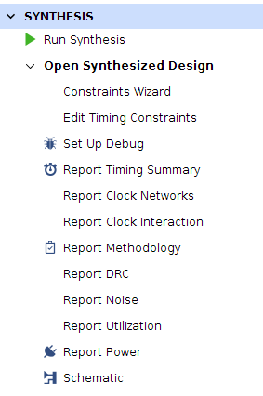
Exploring synthesis report (mvm_uart_system):
Reports available after synthesis
Input: Only your systemVerilog code
i.e. The tool was not given data on how your inputs and outputs are going to match to real world fpga pins
Constraints file provides the pin mapping of inputs and outputs
All synthesis reports are approximates
Overutilization and timing violation reported here might not exist when implemented on FPGA
Why are some of these issues resolved
What is “overutilization” and “timing violations”?

Slide 36
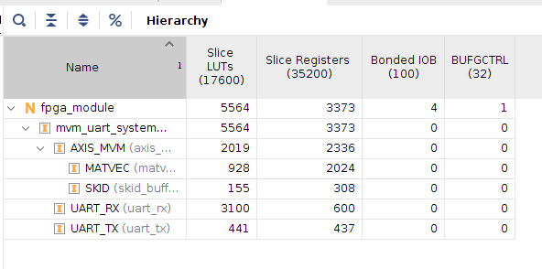
Exploring synthesis report (mvm_uart_system):
Utilization report
Total resources available
Total resources used
Around 33% LUTs and 10% of FFs. This more than good enough

Slide 37
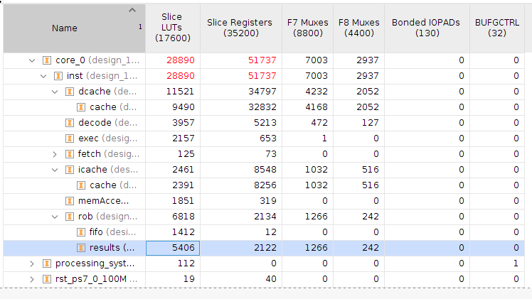
Exploring synthesis report (example over utilization):
Example from a final year project
Utilization report
Over utilization
This can’t be synthesized on the zybo because of the high resource requirements
Thankfully we were able to fix this

Slide 38
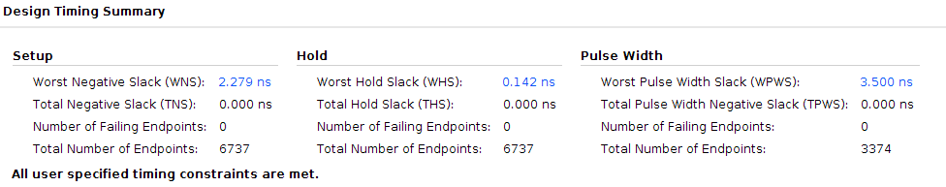
Exploring synthesis report (mvm_uart_system):
Timing report
Slack is good
Slack means we can do more calculations on paths
Timing report is more detailed
Unfortunately there is no time to go through all reports

Slide 39
Implementation
What are the problems that we are trying to solve?
After synthesis we have a netlist of FPGA synthesizable components
We still don’t have the physical location of the LUTs we are using
Our reports are still approximates
How does implementation help?
Implementation comprises of the following steps
Optimize the design - Reduce redundant components, etc…..
Place the FFs - Pick the FF primitives in FPGA to implement design
Route the design - Route the FF
Note: We require a constraints file to do implementation

Slide 40
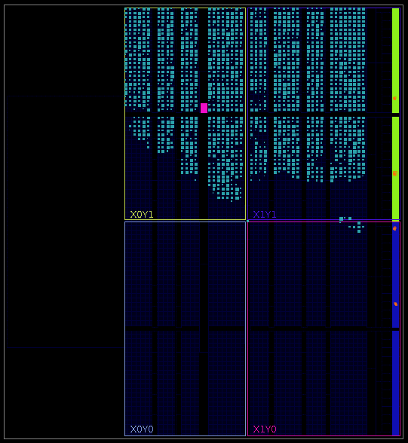
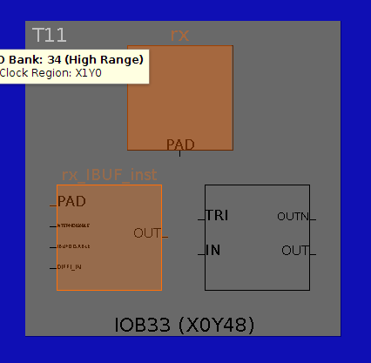
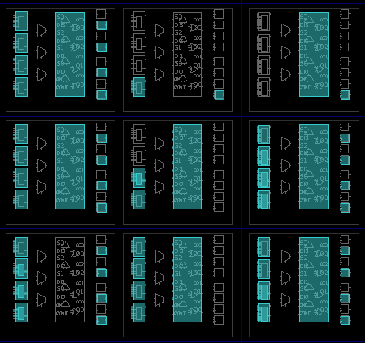
Implemented design:
Zoomed out
Zoomed In
rx pin
Population of FPGA resources

Slide 41
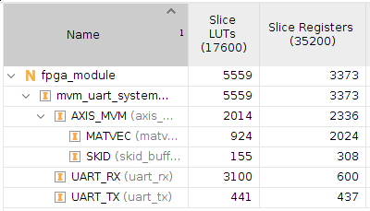
Implementation vs Synthesis (Resource utilization):
Implementation
Synthesis
LUTs used has reduced(although very small)
As design become more complex, efficiency increase in implementation is significant

Slide 42
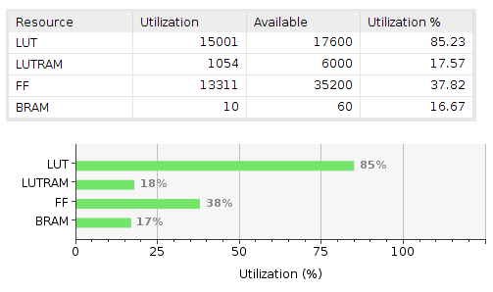
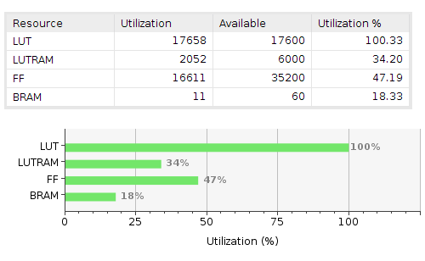
Implementation vs Synthesis (Resource utilization):
Example from a final year project
Implementation
Synthesis
Implementation optimization has reduced resource usage significantly
As design become more complex, efficiency increase in implementation is significant

Slide 43
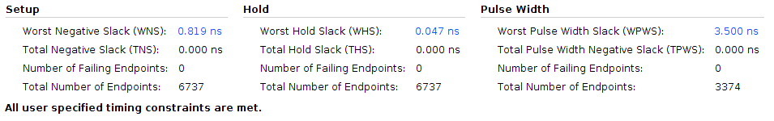
Implementation vs Synthesis (Timing):
Implementation
Synthesis

Slide 44
Now generate bitstream
Don’t connect any cables to computer yet

Slide 45
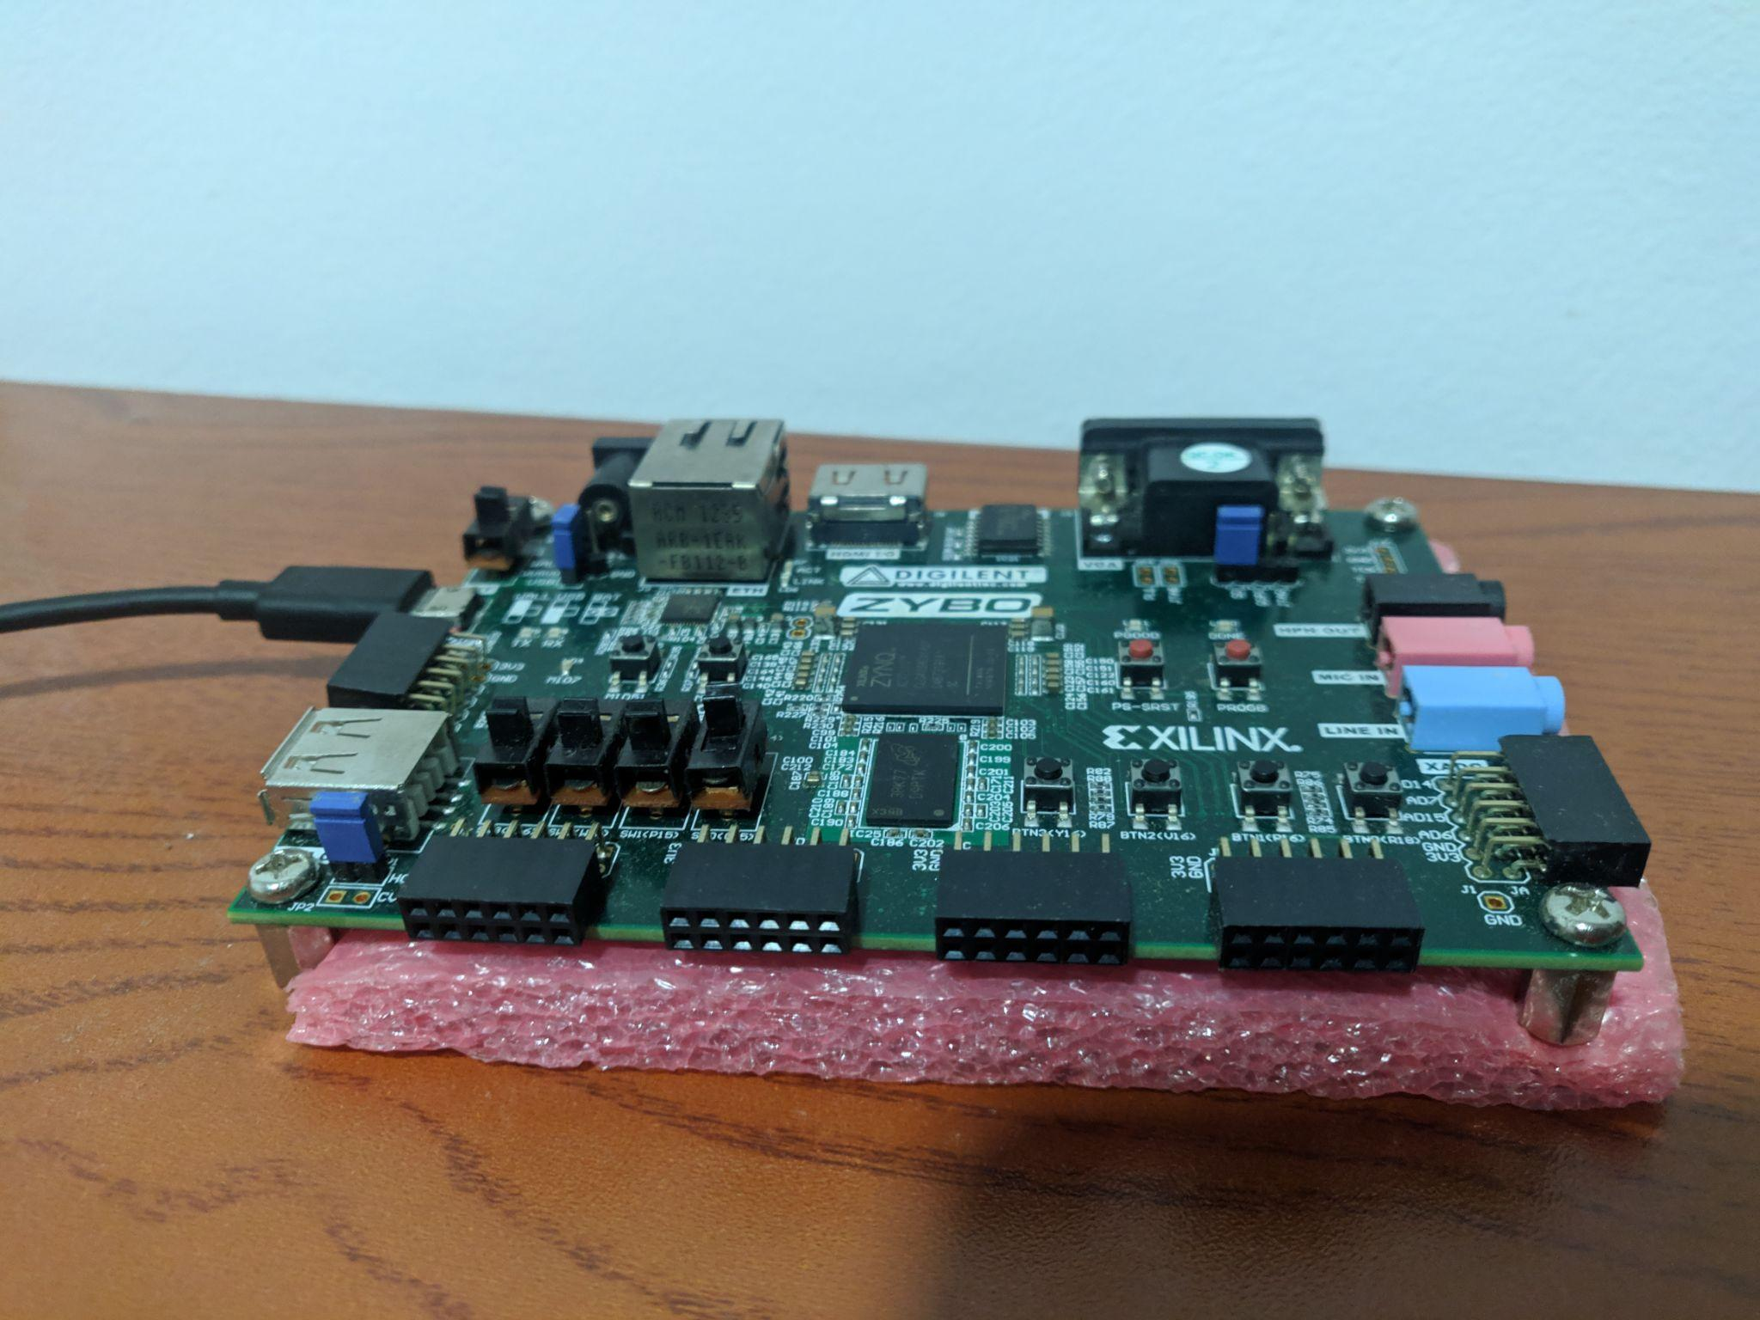
Connecting zybo to USB-tty:
We have assigned our inputs to this(JC) pmod header

Slide 46
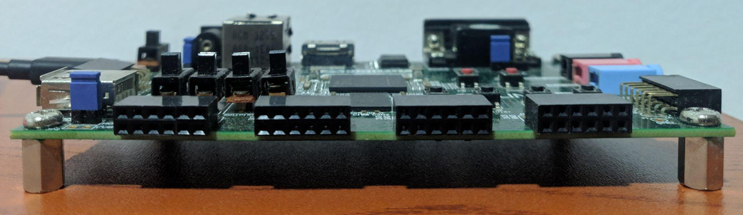
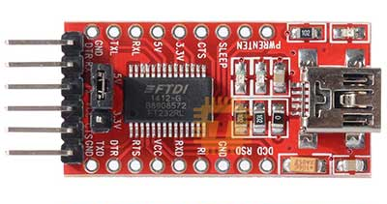
Connecting zybo to USB-tty:
gnd
rx
tx
“rx” of one must connect to the “tx” of the other and vice versa
rx
tx
gnd

Slide 47
Now power-on zybo and
Do not connect tty-USB to computer

Slide 48
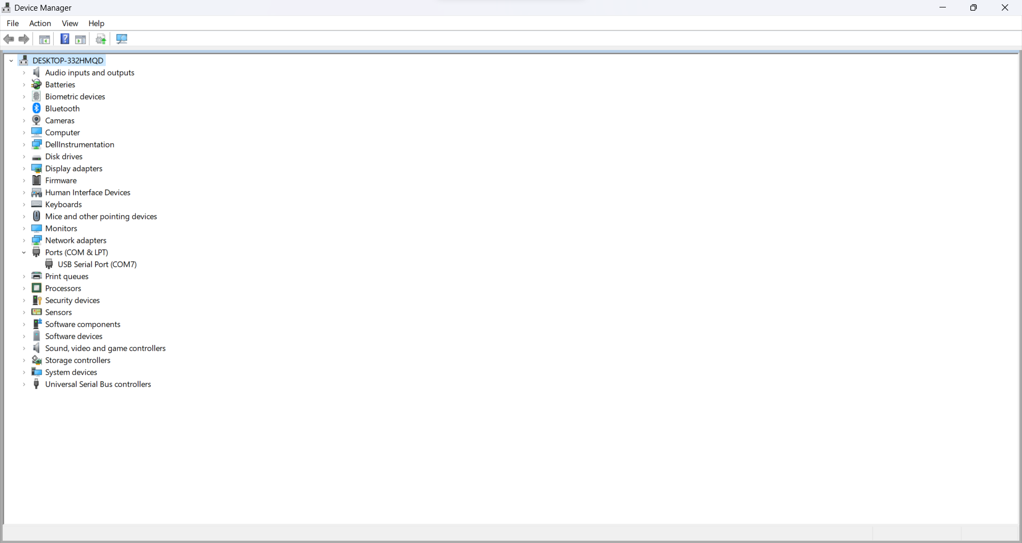
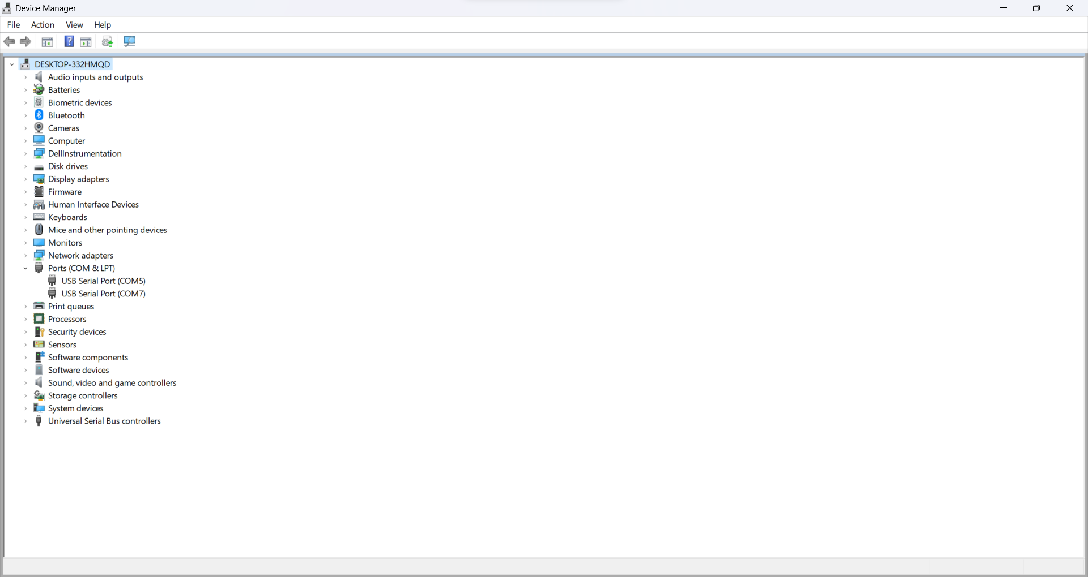
Getting name of UART (Windows):
Open device manager and observe device manager before and after plugging in USB-tty to laptop
before
after
Name of uart “COM5”

Slide 49
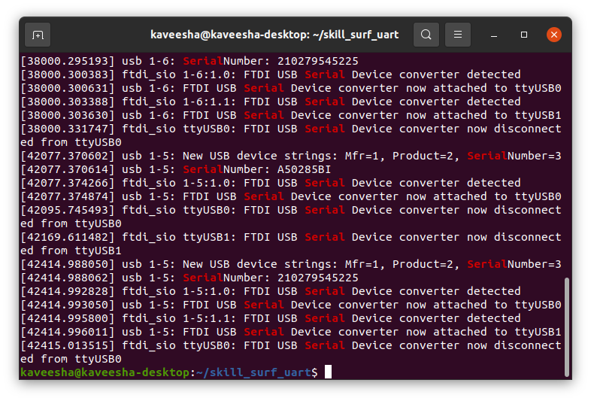
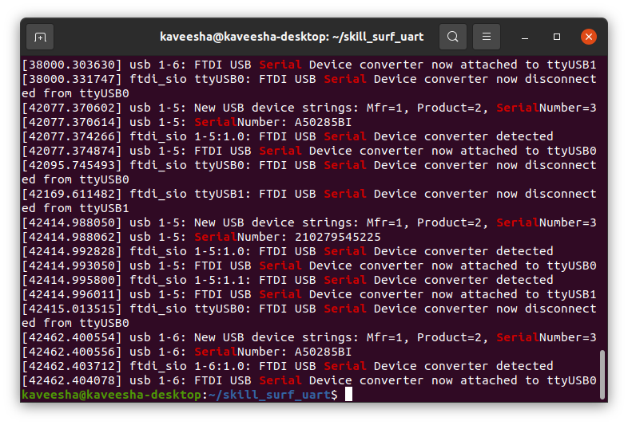
Getting name of UART (Linux):
Run command “sudo dmesg | grep Serial” before and after plugging in USB-tty to laptop
before
after
Name of uart “/dev/ttyUSB0”

Slide 50
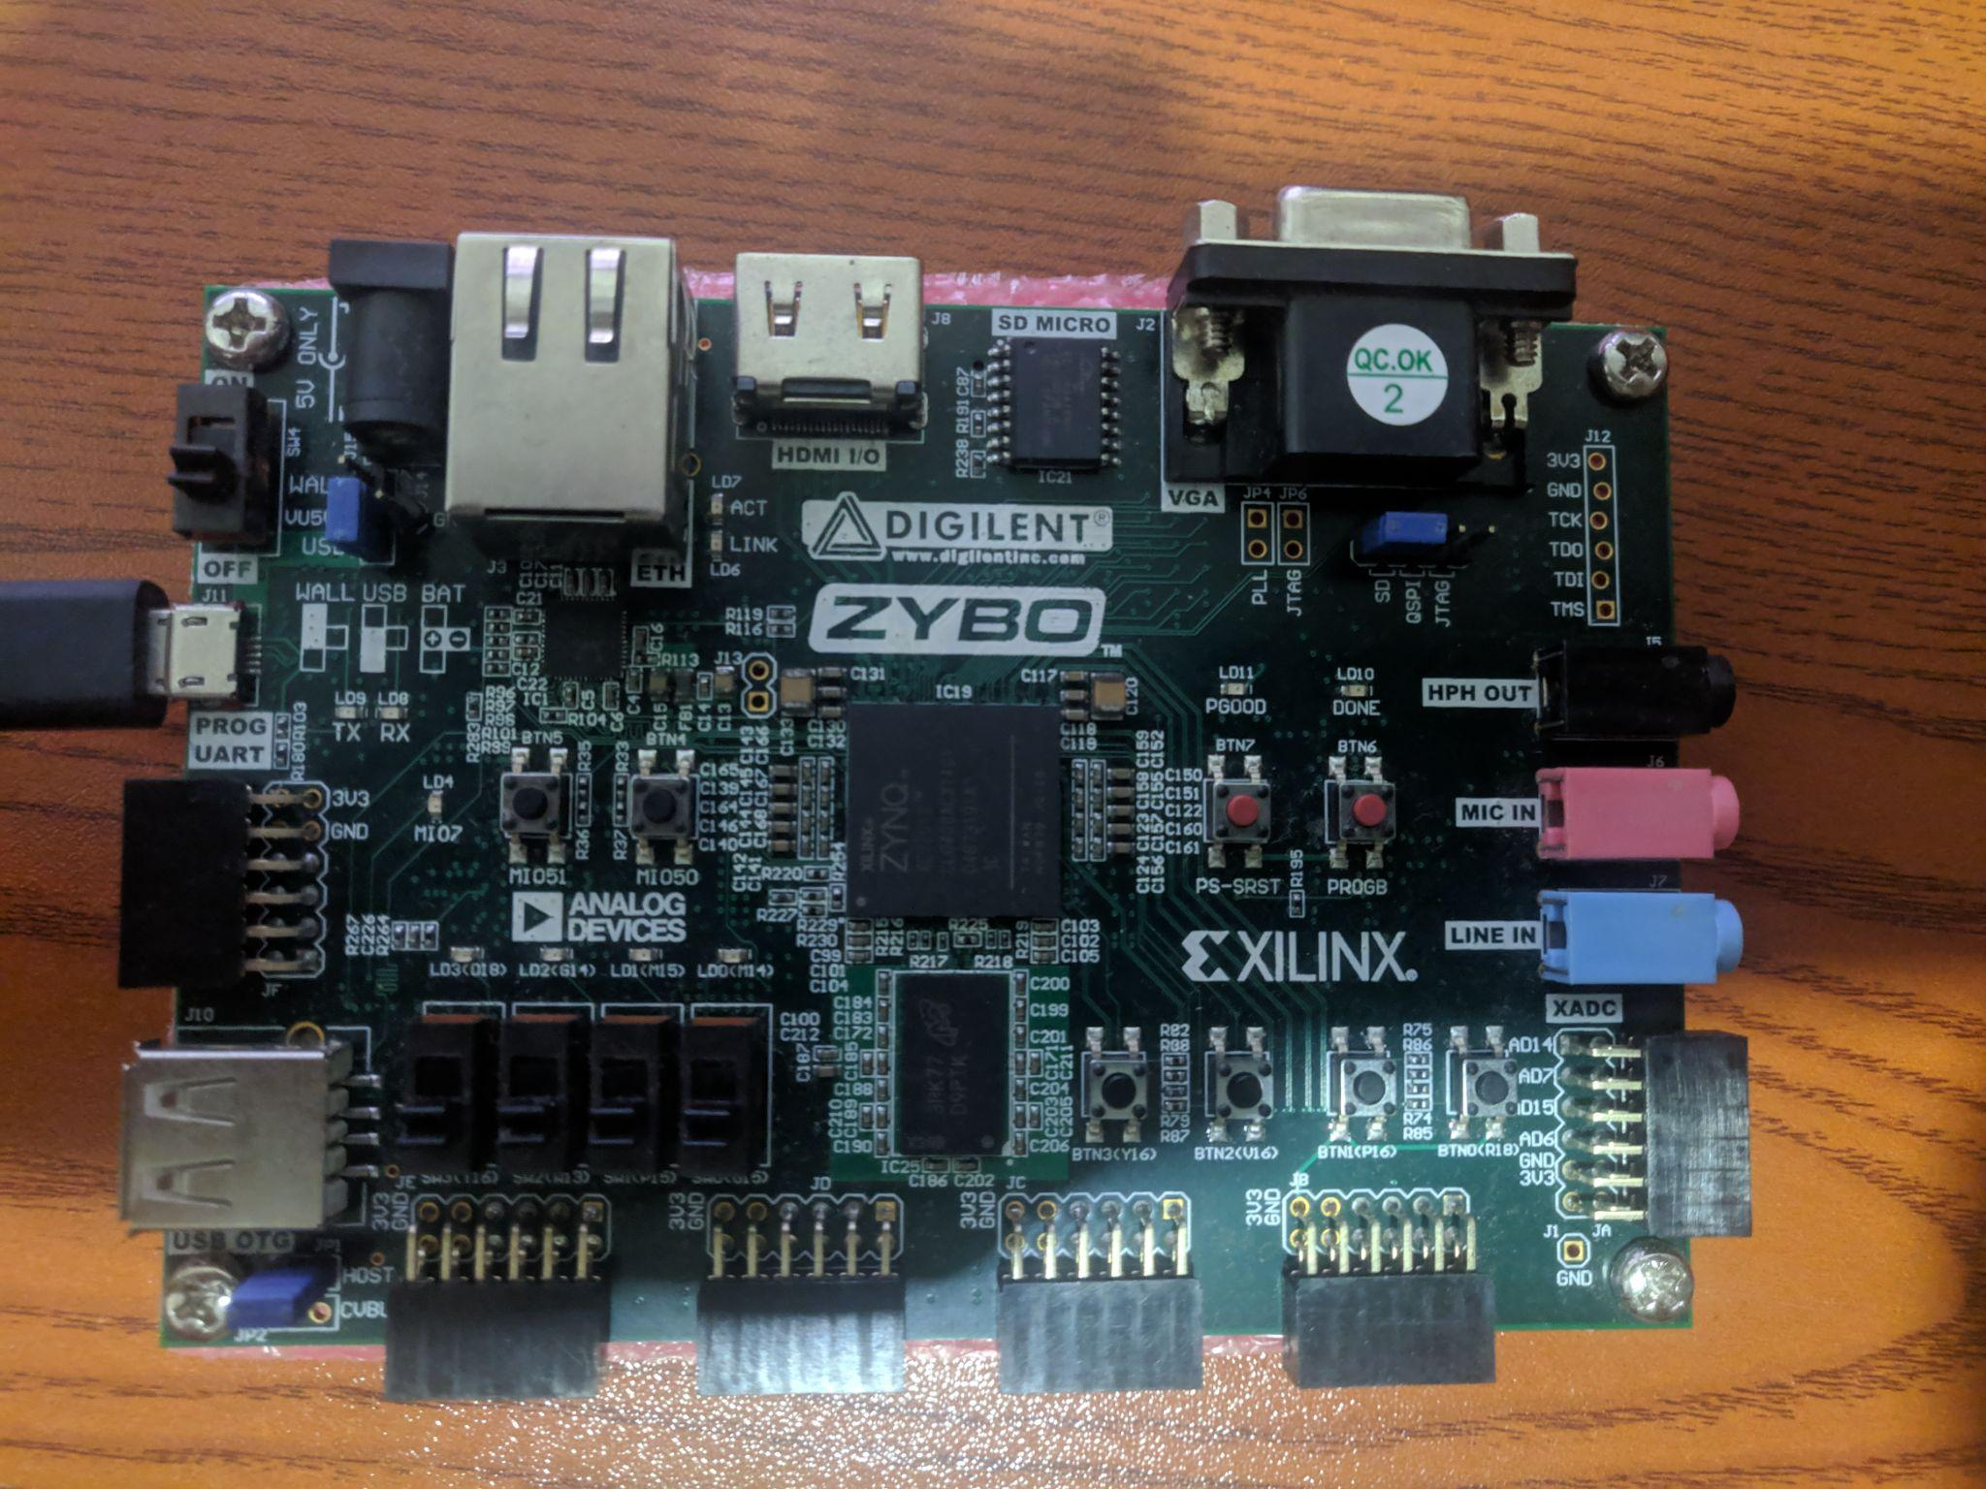
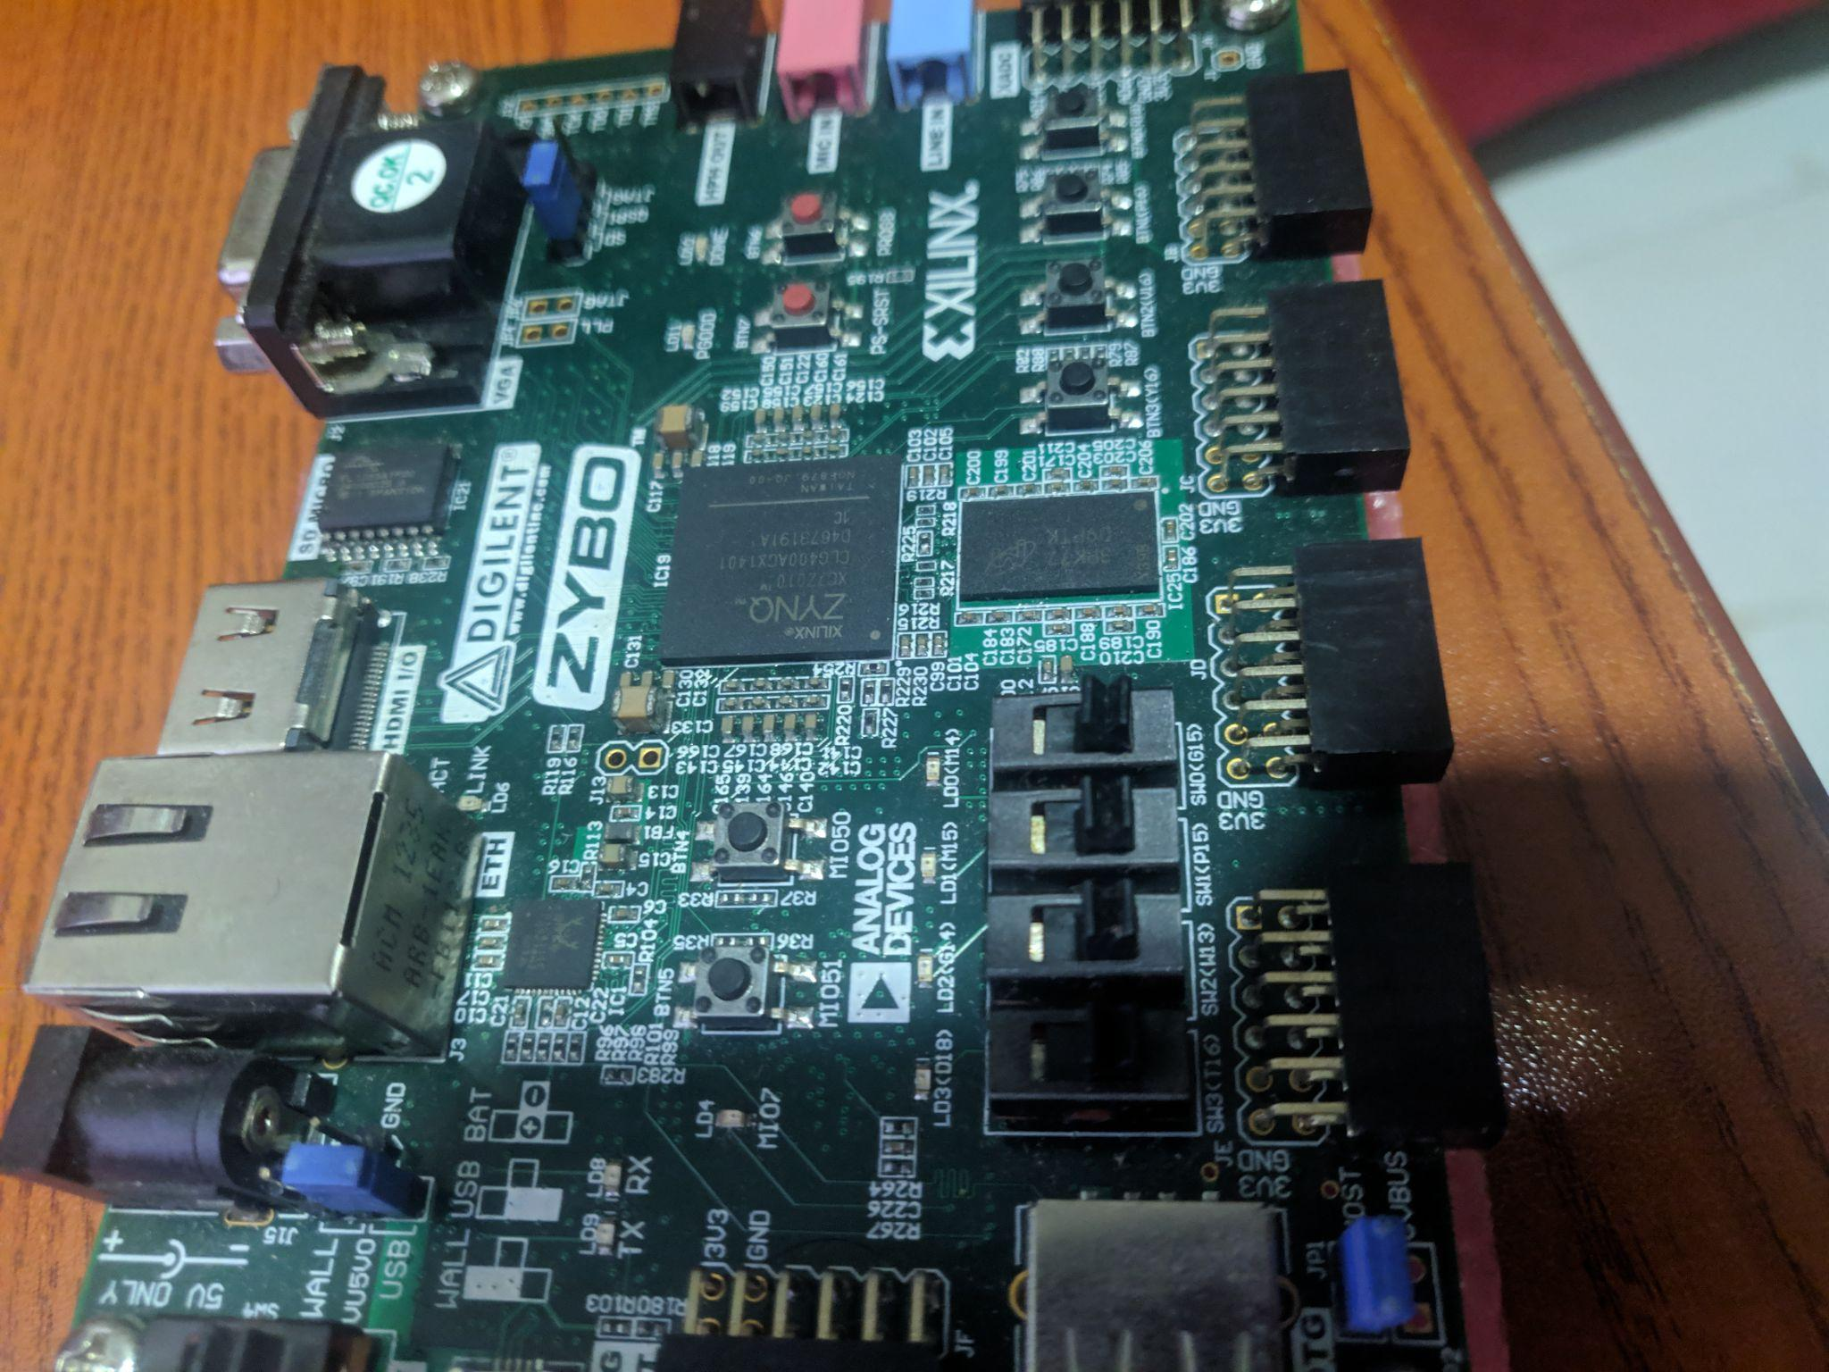
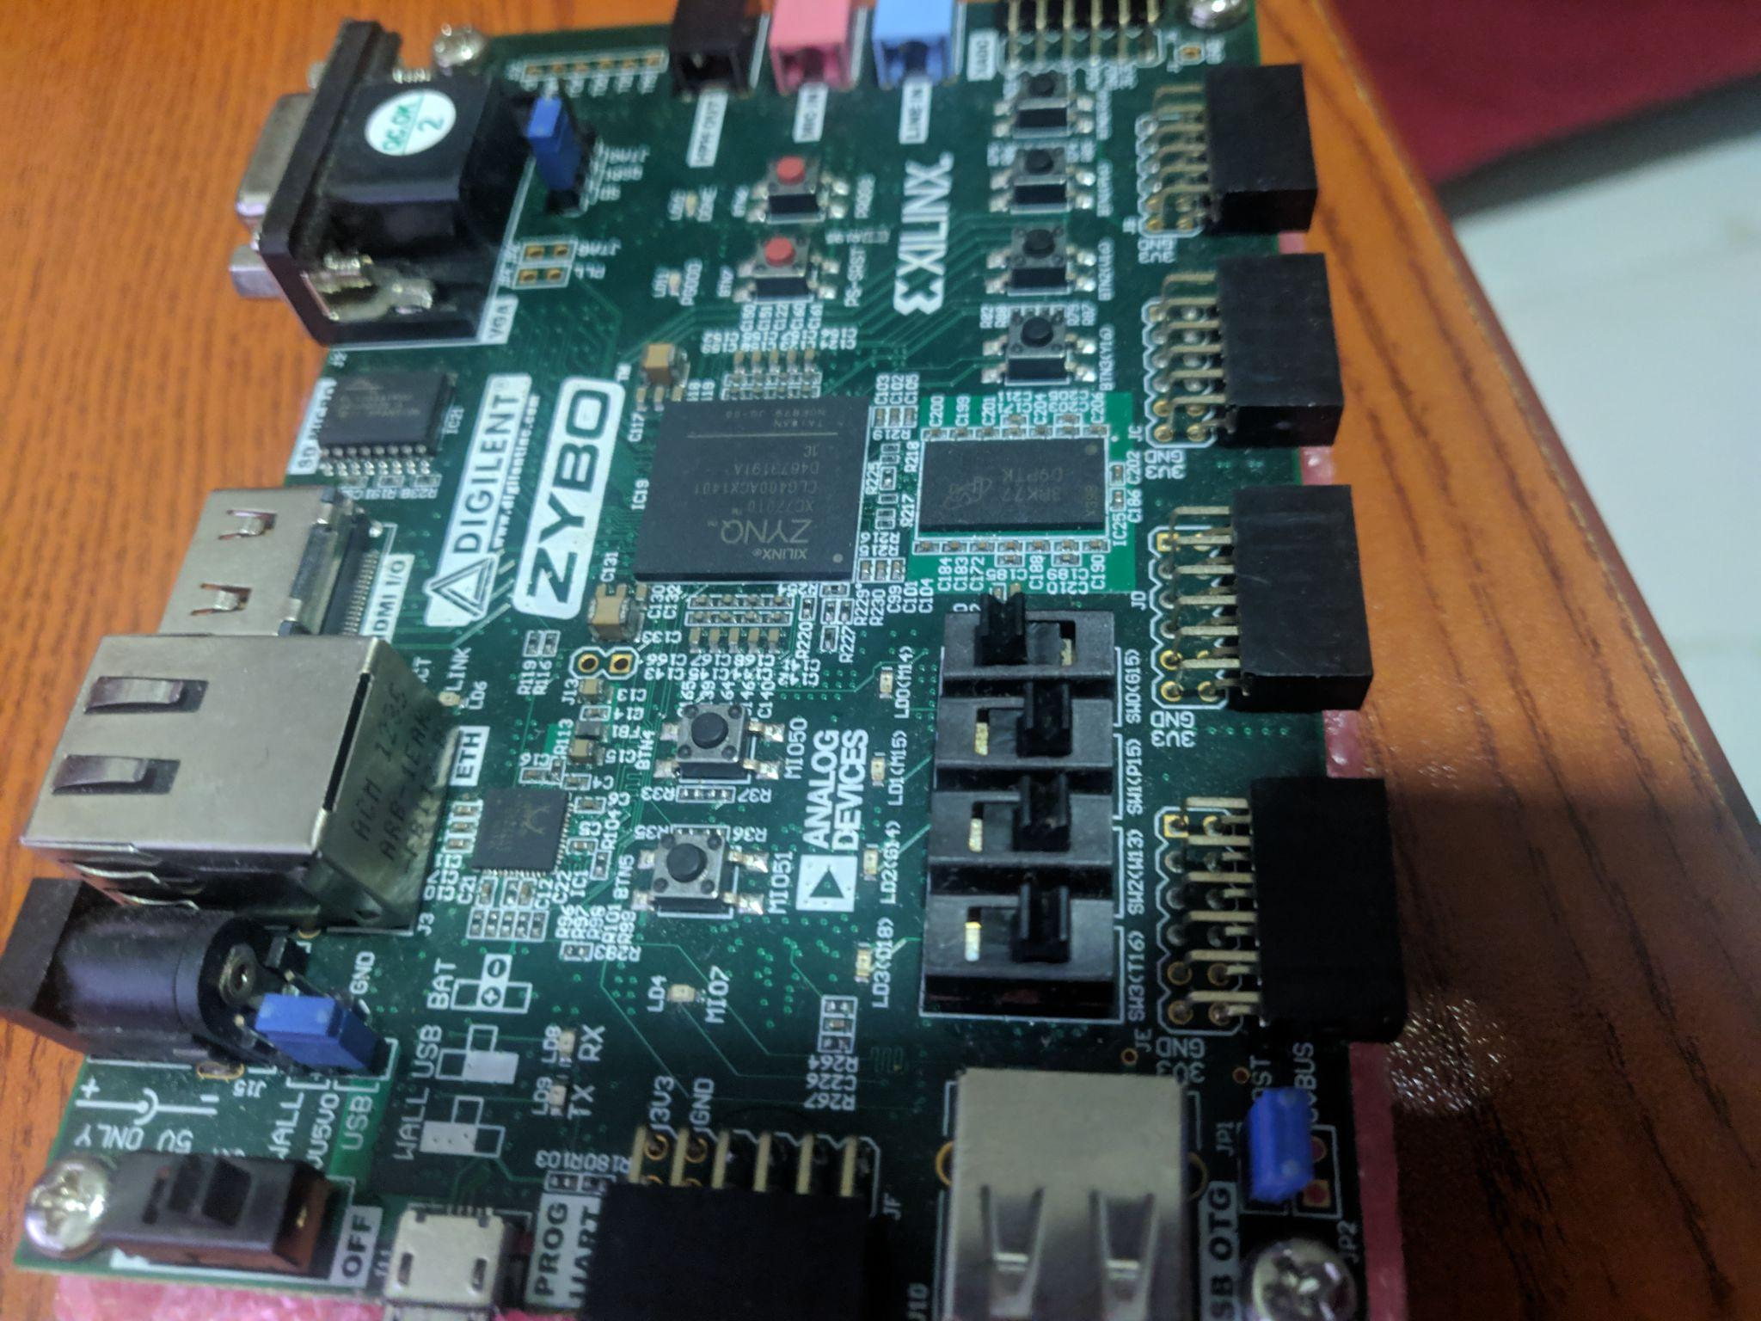
Program FPGA and reset circuit:
To reset circuit
Turn off sw[0]
Turn on sw[0]
* we mapped “rstn” to sw[0] on zybo
sw[0]
sw[0] turned off
sw[0] turned on

Slide 51
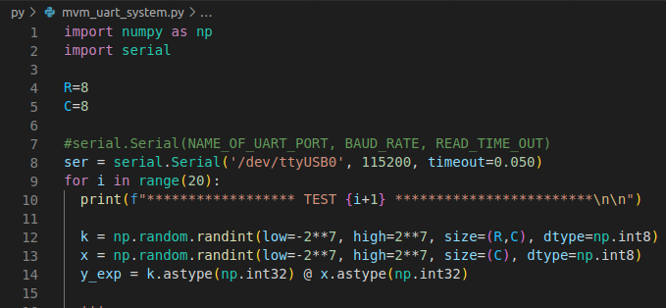
Configuring the python script(only a part of script shown here):
**IMPORTANT**
Change “/dev/ttyUBS0” to the name of your uart port
Run Script
Windows: your preferred way of running python scripts
Linux: sudo python3 mvm_uart_system.py

Slide 52
Any Questions?

